Slide 1
BIOINFORMATICS
Next Generation Sequencing
Federico M. Giorgi, PhD
Department of Pharmacy and Biotechnology

Slide 2
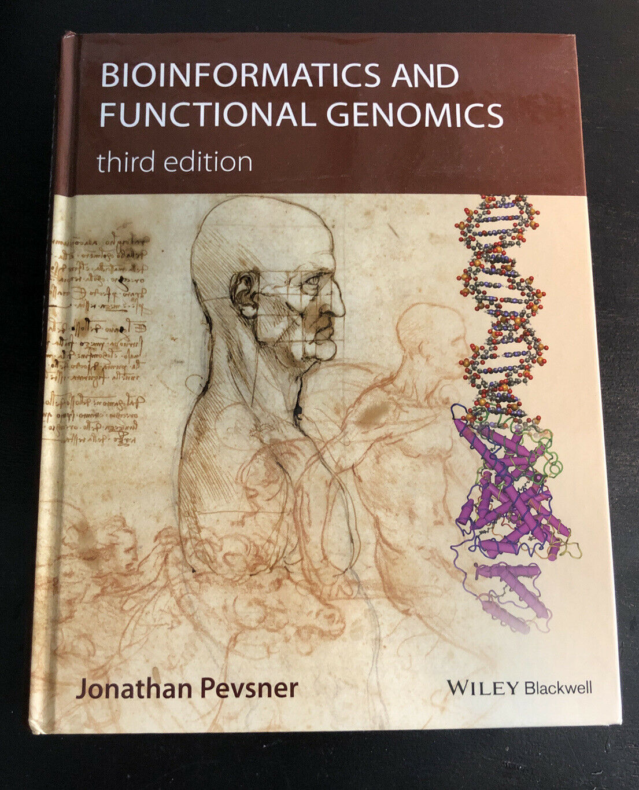

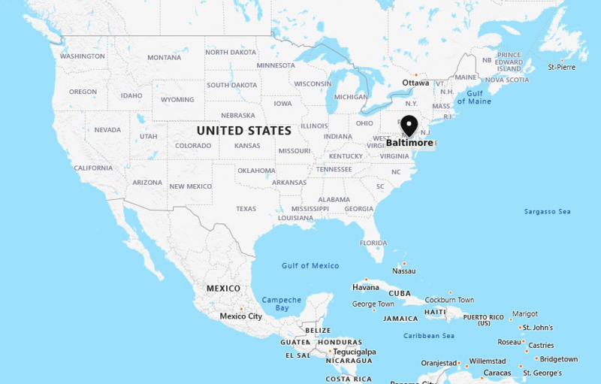

The Book of this Course
Bioinformatics and Functional Genomics – third edition
By Jonathan Pevsner
http://pevsnerlab.kennedykrieger.org/php/index.php

Slide 3
Chapter IX
Next Generation Sequencing Data

Slide 4
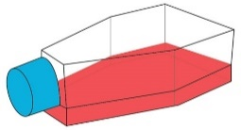
Next Generation Sequencing
Biological samples:
Wild-Type Cells
(3 replicates)
Mutated Cells
(3 samples, e.g. KO)

Slide 5
Next Generation Sequencing of mRNA
Extract all mRNAs
polyT capturing anchors
ribosomal depletion (e.g. RiboZero)
Biological samples:
Wild-Type Cells
(3 replicates)
Mutated Cells
(3 samples, e.g. KO)

Slide 6
Next Generation Sequencing of mRNA
AAAAAA
mRNAs
AAAAAA
AAAAAA
Reverse Transcription
(cDNA)
Fragmentation

Slide 7
Fragmentation of cDNA
Number of fragments is proportional to gene expression

Slide 8
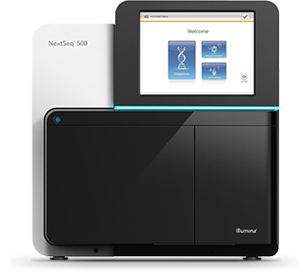
Fragments are sequenced
CATGCATGCATCGATCGANC ATGCGCACATGCATGCATCG
GTTGGGACGTAATGCGCACA
TCGANCTGTATTTTTACGGA
TGGAAGCCCCCCTGATGCAT
GCATGCTGGAAGCCCCCCTG
AGGTATGGAGGGTGGTGGAG
Next-Generation Sequencer
e.g. Illumina NextSeq 500
Sequences
(Correlated to nr of fragments)
(Correlated to transcript expression)

Slide 9

Next Generation Sequencing
CATGCATGCATCGATCGANC ATGCGCACATGCATGCATCG
GTTGGGACGTAATGCGCACA
TCGANCTGTATTTTTACGGA
TGGAAGCCCCCCTGATGCAT
GCATGCTGGAAGCCCCCCTG
AGGTATGGAGGGTGGTGGAG
What to do with these sequences?

Slide 10
Align Reads over Genome
Reads:
Align sequences over Reference Genome
CATGCATGCATCGATCGANC ATGCGCACATGCATGCATCG
GTTGGGACGTAATGCGCACA
TCGANCTGTATTTTTACGGA
TGGAAGCCCCCCTGATGCAT
GCATGCTGGAAGCCCCCCTG
AGGTATGGAGGGTGGTGGAG
TCGANCTGTATTTTTACGGA
ATGCGCACATGCATGCATCG
Sequencing Reads
GTTGGGACGTAATGCGCACA
CATGCATGCATCGATCGANC
GTTGGGACGTAATGCGCACATGCATGCATGCATCGANCTGTATTTTTACGGA
Reference Genome

Slide 11
Next Generation Sequencing
TCGANCTGTATTTTTACGGA
ATGCGCACATGCATGCATCG
Sequencing Reads
GTTGGGACGTAATGCGCACA
CATGCATGCATCGATCGANC
GTTGGGACGTAATGCGCACATGCATGCATGCATCGANCTGTATTTTTACGGA
Reference Genome
Information:
Read sequences
Where they align on the genome
BAM file
+BAI file (BAM index) to speed up the access

Slide 12
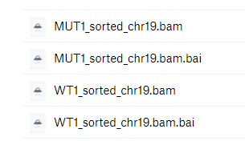

Let’s start!
Download all files from
https://www.dropbox.com/sh/ppdyj6f041bvt4t/AAC6-LYBNHLm5wdqb1FL7J3ra?dl=0
BAM file: sequencing reads aligned on genome (big file)
BAI file: index for BAM, for fast retrieval (small file)
Experimental setup
Transcriptomics sequencing (RNA-Seq)
Mutant sample (MUT1) vs. Wild Type sample (WT1)
Species: mouse cells
Chromosome: 19 (to keep files small)

Slide 13
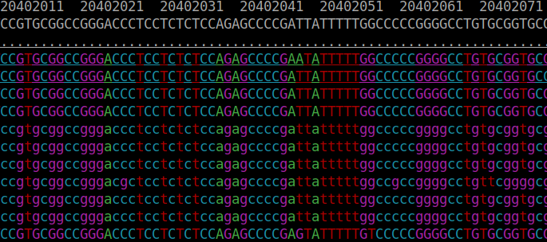
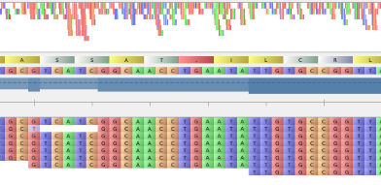


Visualizing BAMs
samtools tview
Command line
Fast
Weak
Tablet
The first beautiful GUI
SeqMonk
For ChIP-Seq
Integrative Genomics Viewer
Everyone uses this

Slide 14
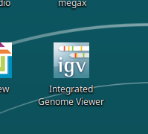
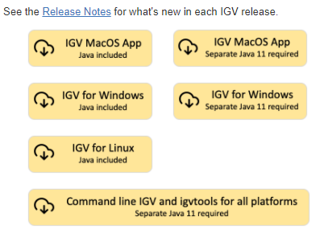

Integrated Genome Viewer (IGV)
Local version
Pre-installed on the lab’s computers
You can download/install it from
https://software.broadinstitute.org/software/igv/download
It runs on JAVA, a very efficient cross-platform language that is somehow declining in popularity.
So, better maybe to download the “Java included” version
Alternatively, if your computer is not super-performing, the IGV online version at https://igv.org/app/

Slide 15
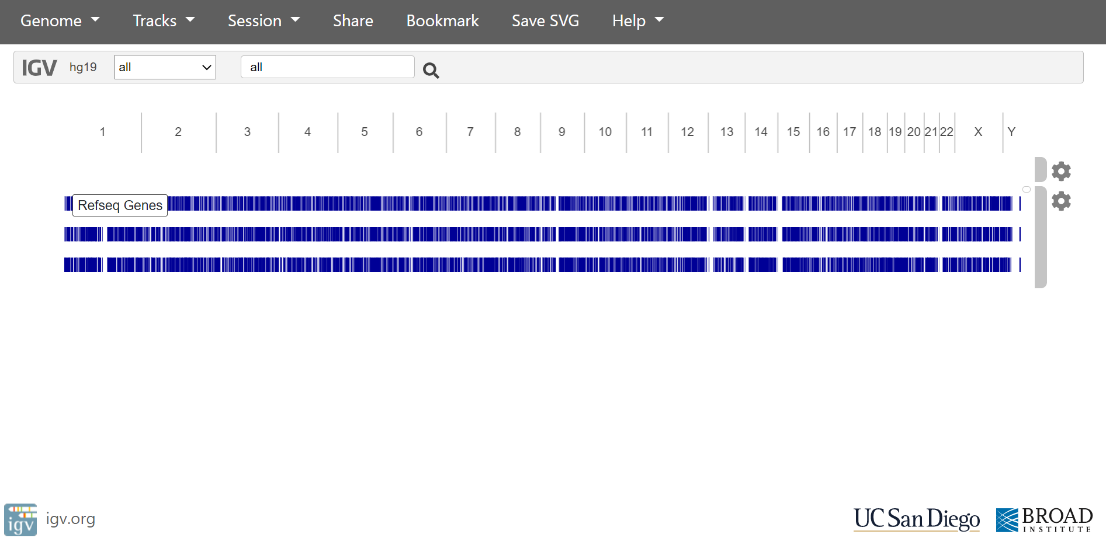
IGV.org

Slide 16
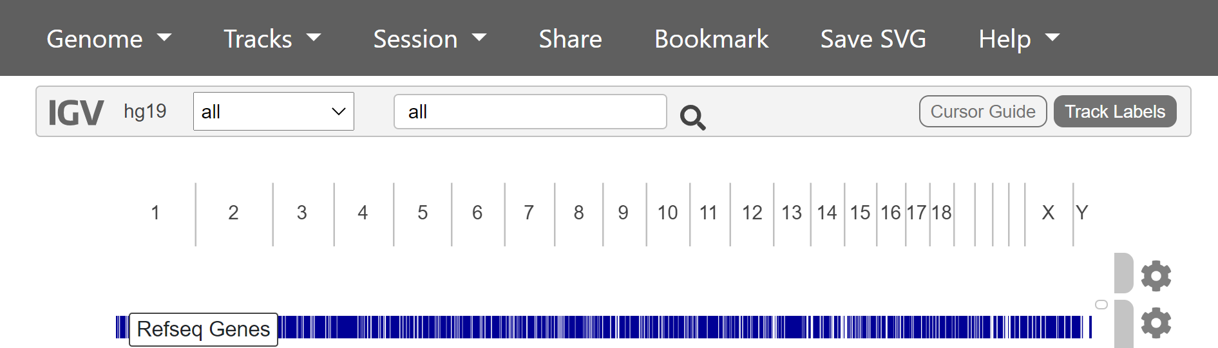
IGV.org
First thing: set the correct genome!
Our dataset is aligned on mouse genome version mm10
Same thing:
mm10: UCSC nomenclature
GRCm38: NCBI nomenclature
For human (most recent):
hg38
GRCh38

Slide 17
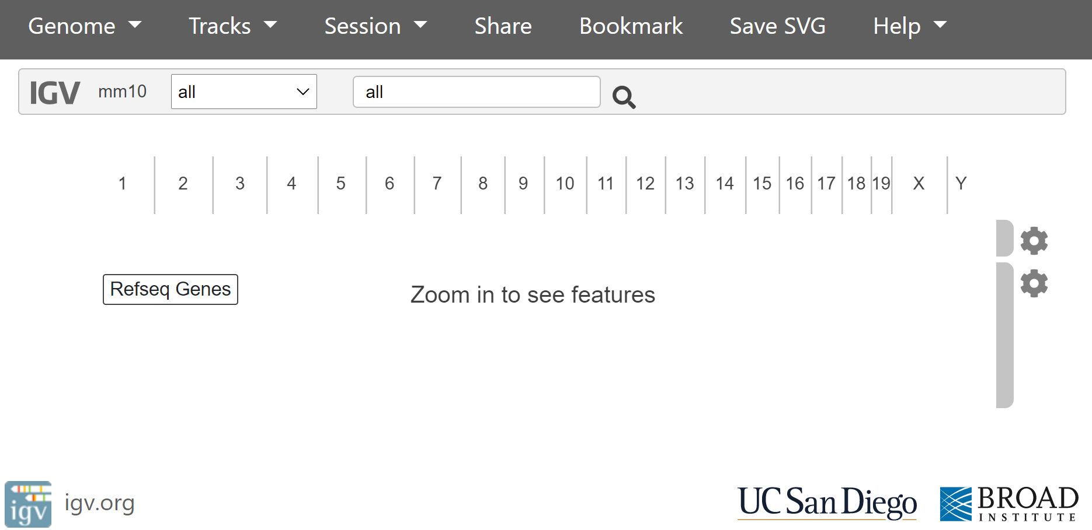
IGV.org – mm10 genome

Slide 18
IGV.org – load your BAM
https://igv.org/app/
Click on Tracks and load the BAM file for experiment WT1

Slide 19
IGV.org – load your BAM
https://igv.org/app/
Click on Tracks and load the BAM file for experiment WT1

Slide 20
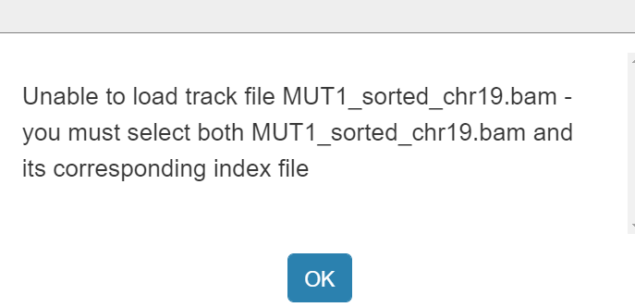
IGV.org – load your BAM… and BAI

Slide 21
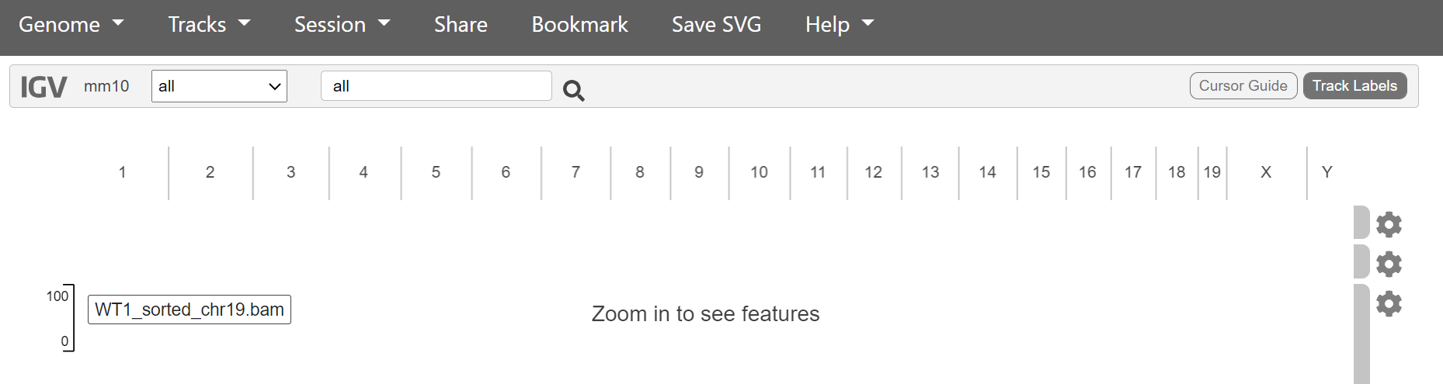
IGV.org experiment loaded

Slide 22
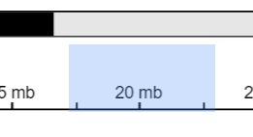


IGV experiment
BAM file: sequence reads and coordinates
BAI file: extra index file
Loaded: WT1_sorted_chr19.bam
To keep it small and downloadable even if you don’t have fast connection, only chromosome 19 sequences are contained
Sample name
The BAM is sorted by coordinate (faster access)
Go to chromosome 19!
It’s too long, you have to zoom in to see features. Many ways:
Drag little rectangle on chromosome coordinate
Click on +
Search for a gene, e.g. Ccs
Search for coordinate, e.g. chr19:25,421,476-25,427,225

Slide 23
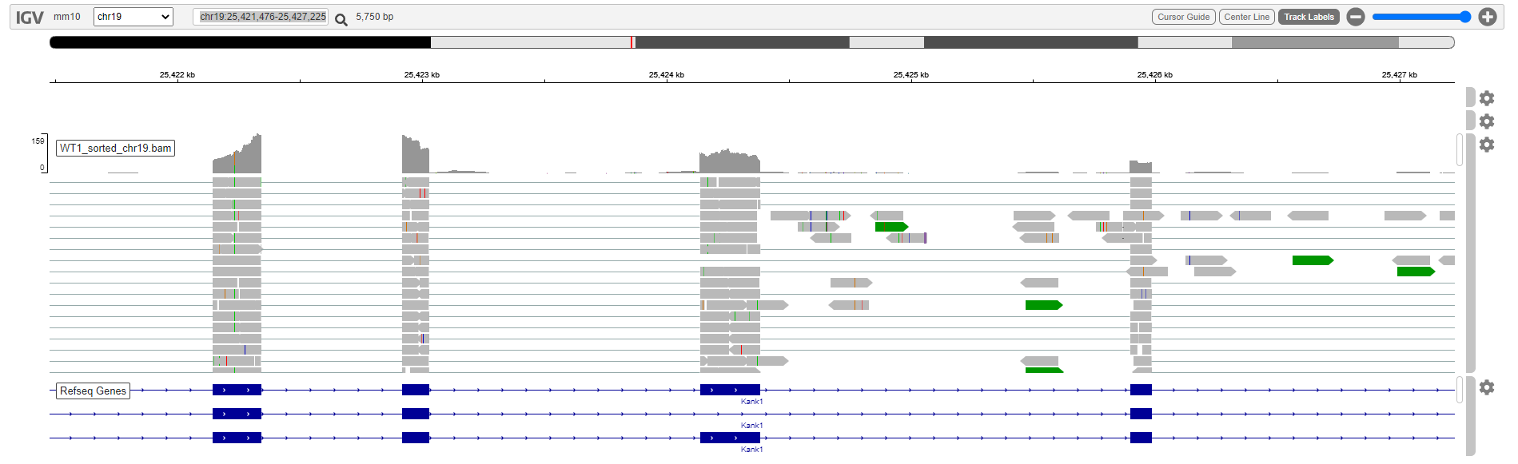
Visualizing an NGS experiment
OK so, what are we looking at?

Slide 24
The experiment, visualized graphically
The genomic coordinates
Gene tracks (static, the same in every experiment)
Introns, exons, direction of the gene
“Reads” from sequencing: these are pieces of RNA from mouse cells. This visualization shows where they align on the genome
Rectangles: alignment
Lines: alignment skips (e.g. over introns)

Slide 25
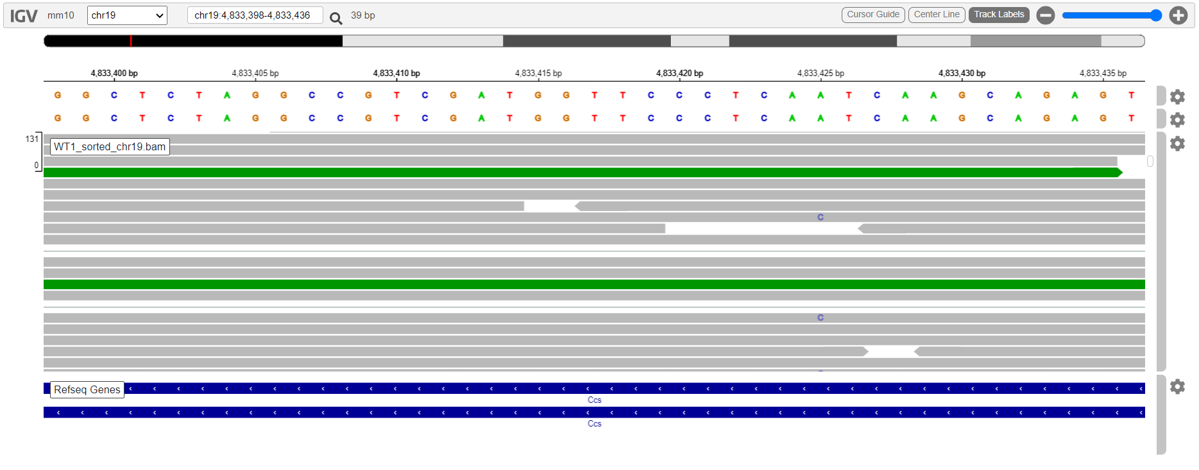
Keep zooming in
You will see
Individual nucleotides
Mutations (or sequencing errors?)

Slide 26
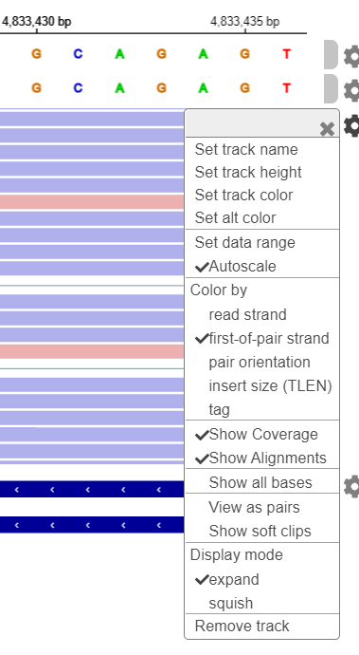
IGV: All Genomics in a nutshell
RNA-Seq experiment visualized as alignment shows:
Gene expression levels
Differential Gene Expression levels
Variants (single nucleotide or short indels) from reference genome
Errors: isolated “mutations”
Real mutations: more frequent (remember: we have two alleles for each gene)
Splicing
Alternative Splicing
Transcript Orientation

Slide 27
Exercises using IGV
Find genes with novel alternative splicing (e.g., exon skip) supported by at least one read
Suggestion: Kank1
Load also the MUT1 file and compare it with WT1
Check genes that are differentially expressed
E.g., Slc1a1, Slc25a45, Cyp2c55, Pnlip
Hint: must scale range for coverage
Find two genes with inverted orientation that may share the same promoter
E.g. Rnls
This is an RNA-Seq file, can you imagine what a whole genome sequencing alignment will look like?

Slide 28
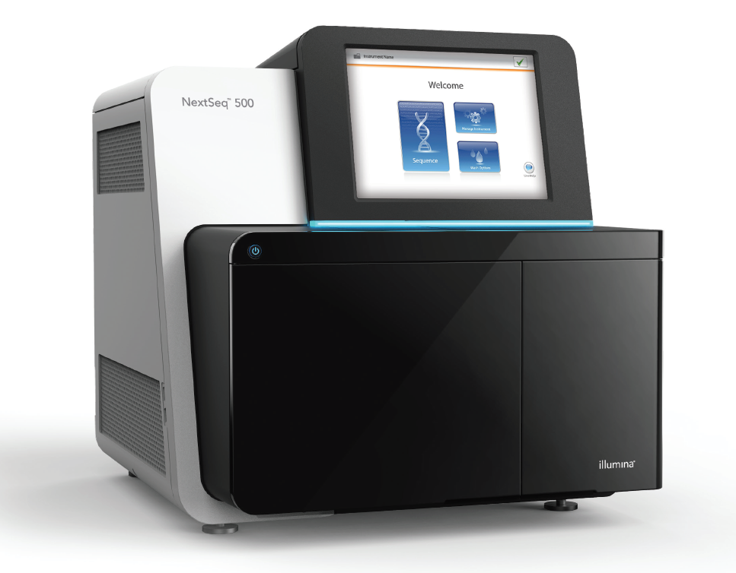
How was the BAM file I gave you generated?
Starting from raw sequencing reads
Then the reads are aligned on a reference genome
On LINUX, with a high-performance machine (64GB of RAM)
These are usually generated by a next generation sequencer
Illumina, SMRT PacBio, Nanopore, Roche 454, etc.

Slide 29
Sequencing Techniques
throughput
Illumina NextSeq
Illumina MiSeq
Sanger
Illumina HiSeq
Quality
Oxford
Nanopore
SMRT
PacBio
Solexa
Roche 454
20
100
300
600
2000
10000
50000
Length (nt)
They all produce the same file formats (e.g., BAM)

Slide 30

Illumina Sequencing (Video Slide)

Slide 31

Illumina Sequencing (Video Slide)

Slide 32

Sample preparation (Illumina)
1.
*For Affymetrix microarrays, 2-3μg
Purify mRNA
Starting with 0.1-4μg of total RNA*
Polyadenylated RNA (mRNA) is purified via poly-T oligo-attached magnetic beads
mRNA
TTTTTTT
TTTTTTT
AAAAAAA
other RNA
TTTTTTT
TTTTTTT
TTTTTTT
2.
Fragment mRNA
94°C for 3-8 minutes
In this step, mRNA fragments are also primed for the following cDNA synthesis step
First strand cDNA synthesis primer
(random hexamers)
AAAAAAA

Slide 33
Sample preparation (Illumina)
3.
First strand cDNA synthesis
The cleaved mRNA is transcribed into a single strand cDNA sequence
The reaction requires Reverse Transcriptase and random primers
5’
3’
ss-RNA
5’
3’
3’
5’
Reverse Transcription
3’
5’
ss-cDNA
4.
Second strand cDNA synthesis
The RNA template is removed (like RNAse H)
A second strand of cDNA is synthesized
5’
3’
3’
5’
ds-cDNA
5’
3’
ss-RNA
5’
3’
3’
5’
ss-cDNA
Polymerization
(RNA fragments as primers)
3’
5’
ds-cDNA is very stable at 4°C

Slide 34

Sample preparation (Illumina)
5.
End repair
The dsDNA overhangs need to be transformed into blunt ends
3’-5’ Exonuclease removes 3’ overhangs
Standard DNA polymerase fills the 5’ overhangs
5’
3’
3’
5’
5’
3’
3’-5’ Exonuclease
DNA polymerase
3’
5’

Slide 35
Sample preparation (Illumina)
6
Ligate adapters
Every library gets a couple of specific nucleotide sequences, which are later used as indexes if the sequencing lane is gonna be multiplexed
5’
3’
Sample 1:
1
1
3’
5’
5’
3’
Sample 2:
2
2
3’
5’
7
Selective enrichment
Only fragments with indexes on both sides are enriched via a PCR reaction (primers anneal to the ends of the sequences)
PCR

Slide 36
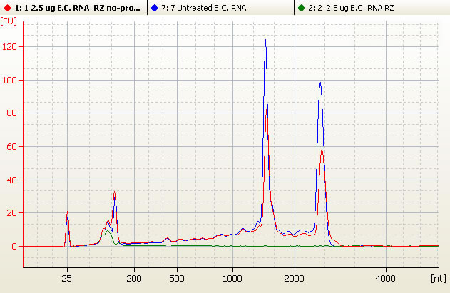
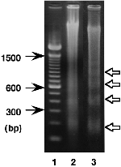
Sample preparation (Illumina)
8
Select fragment size
The size of fragments is standardized by selection on agarose gel
25
100
200
500
1000
2000

Slide 37
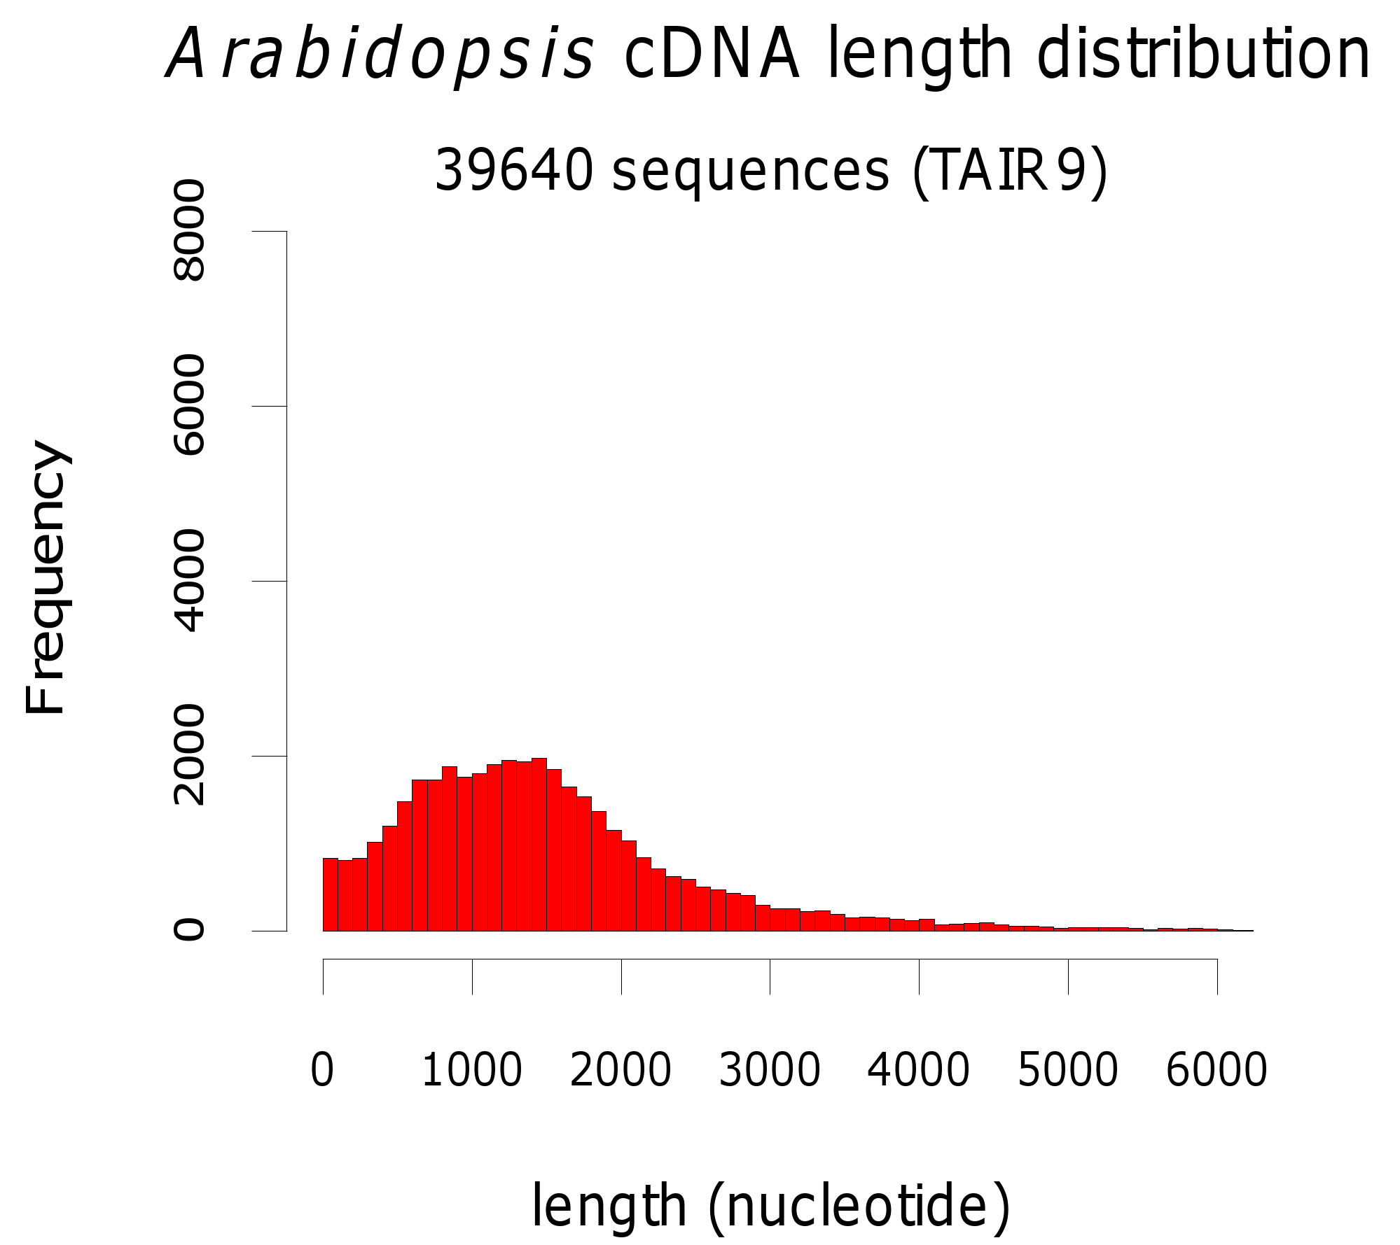
Sample preparation (Illumina)
8
Select fragment size
The size of fragments is standardized by selection on agarose gel
25
100
200
500
1000
2000

Slide 38
RNA-seq: Sequencing (Illumina)
Many different transcripts with a sample index (associated to the sample of origin)
cDNA of the original sequence
5’
3’
5’
3’
1
1
1
1
3’
5’
3’
5’
5’
3’
5’
3’
1
1
1
1
index of the sample of origin
e.g. sample 1
or sample 2
3’
5’
3’
5’
5’
3’
5’
3’
1
1
2
2
3’
5’
3’
5’
5’
3’
5’
1
1
3’
3’
5’
2
2
5’
3’
3’
5’
2
2
3’
5’
5’
3’
5’
3’
2
2
2
2
3’
5’
3’
5’

Slide 39
RNA-seq: Sequencing (Illumina)
Illumina Flow Cell

Slide 40
RNA-seq: Sequencing (Illumina)
Cluster generation: DNA attachment
Single-stranded fragments bind randomly to the inside surface of the flow cell
Illumina Flow Cell

Slide 41
RNA-seq: Sequencing (Illumina)
Cluster generation: Solid-Phase Amplification
Unlabeled nucleotides and enzyme are added to initiate solid-phase amplification
Several million dense clusters of double-stranded DNA are generated in each channel of the flow cell
Illumina Flow Cell

Slide 42
RNA-seq: Sequencing (Illumina)
Sequencing by Synthesis
A
T
C
G
T
G
C
A
T
G
C
G
G
T
Rest of Sequence
Sample Index

Slide 43
RNA-seq: Sequencing (Illumina)
Sequencing by Synthesis
Adding nucleotides with
1) fluorofores
2) reverse terminators
A
T
C
G
T
G
C
A
T
G
C
G
G
T
A

Slide 44
RNA-seq: Sequencing (Illumina)
Sequencing by Synthesis
Adding nucleotides with
1) fluorofores
2) reverse terminators
A
T
C
G
T
G
C
A
T
G
C
G
G
T
C
A

Slide 45
RNA-seq: Sequencing (Illumina)
Sequencing by Synthesis
A
T
C
G
T
G
C
A
T
G
C
G
G
T
The succession of colors in each spot gives the sequence
C
C
A

Slide 46
RNA-seq: Sequencing (Illumina)
Sequencing by Synthesis
A
T
C
G
T
G
C
A
T
G
C
G
G
T
The succession of colors in each spot gives the sequence
G
C
C
A

Slide 47
RNA-seq: Sequencing (Illumina)
Sequencing by Synthesis (Paired Sequencing)
A
T
C
G
T
G
C
A
T
G
C
G
G
T
The same fragment can be sequenced on the other side as well
This reaction starts with a second, different primer, and happens after the first reaction
In this case, both sequences are called a pair

Slide 48
RNA-seq: Sequencing (Illumina)
Sequencing by Synthesis (Paired Sequencing)
This way, you can have TWO reads sequencing two borders of a longer fragment
acagtcag
gtcagtaat
Read 1 = Read 2 = 30 to 350 nt
Fragment ≥ 150nt

Slide 49
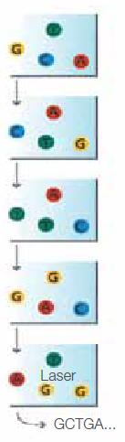
RNA-seq: Sequencing (Illumina)
Sequencing Over Multiple Chemistry Cycles
The sequencing cycles are repeated to determine the sequence of bases in a fragment, one base at a time
Multiplexing deconvolution
Based on the index, reads in multiplexed lanes are assigned to their specific sample, and written in their specific FastQ

Slide 50
Exercise
How long were the reads in the BAM file I gave you?

Slide 51
Examples of Next Generation Sequencing

Slide 52
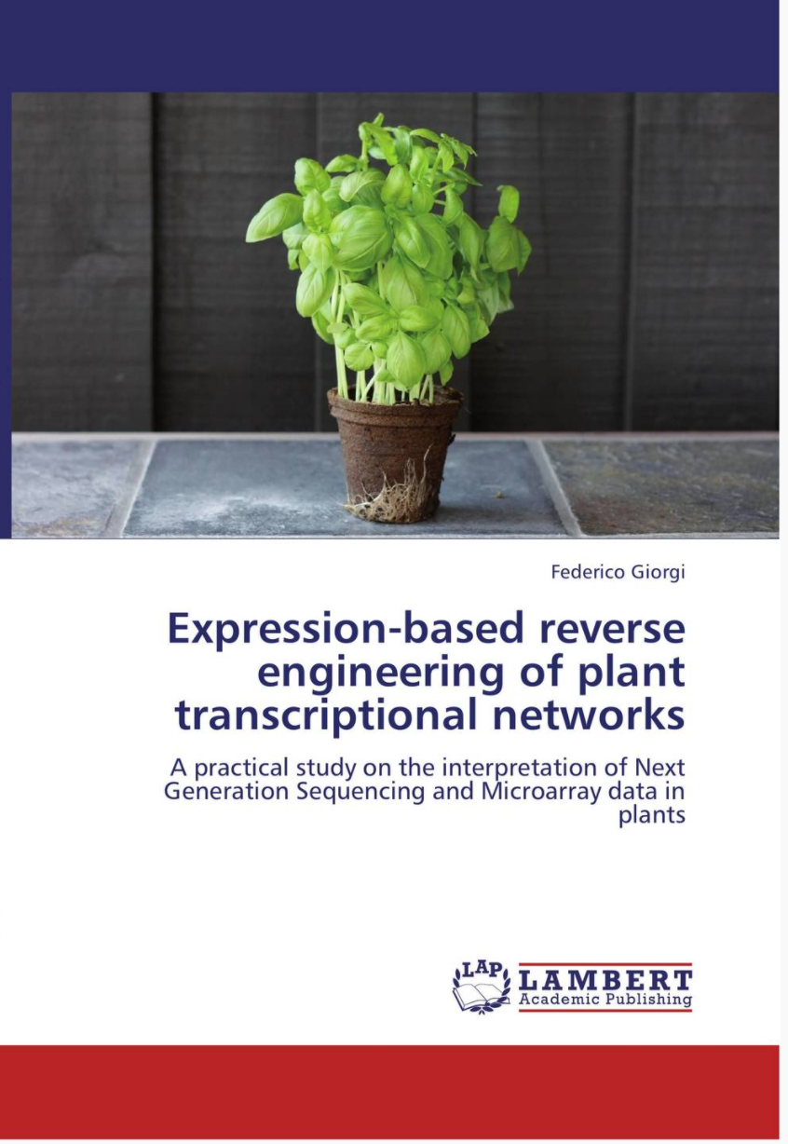
Next Generation Sequencing: Applications
Whole Genome Sequencing
Whole Exome Sequencing
Chromatine ImmunoPrecipitation (ChIP) Sequencing
RNA Sequencing
Qualitative (catalogue of transcripts, alternative splicing)
Quantitative (differential expression)
More (e.g. reverse engineering of gene networks)
Metagenomics
Metatranscriptomics

Slide 53
The most popular codes in Next Generation Sequencing
WGS: Whole Genome Sequencing
WXS: Whole eXome Sequencing
ChIP-Seq: Chromatine ImmmunoPrecipitation Sequencing
RNA-Seq: RNA Sequencing

Slide 54
Whole Genome Sequencing
The easiest
Take DNA from sample, fragment it, sequence it
Typical profile on IGV:
Uniform coverage
No splicing
Genome
Coverage Profile (WIG)
Reads

Slide 55
Whole Exome Sequencing
Starting from DNA
Enrich only regions containing EXONS
In some cases, only exons of specific genes (e.g. cancer genes)
How is the enrichment performed:
PCR methods (amplify all exons)
Probe-specific capture (array-based or in-solution)
Uses:
Detecting mutations in the coding sequence
Single-nucleotide
Short indels

Slide 56
Whole Exome Sequencing
Typical profile on IGV:
Non-uniform coverage
No splicing
Most reads mapping on exons
Non-exon reads are rare (they were not enriched for)
Genome
Coverage Profile (WIG)
Reads
Genes
Exon
Intron
Exon
Intron
Exon

Slide 57
RNA Sequencing
Starts from RNA
99.9% of the cases, messenger RNA (more informative of the cell state)
RNA is converted to cDNA, then fragmented, then sequenced
Useful for:
Measuring gene expression
Measuring differential gene expression
Detecting mutations on the expressed sequences
Identifying new isoforms
When compared with WXS/WGS:
RNA editing (detect mutations generated post-transcription)
Allele-Specific expression (see if one allele is more expressed than the other)

Slide 58
RNA Sequencing
Typical profile on IGV:
Non-uniform coverage
Presence of splicing
Reads tend to localize precisely on exons
Genome
Coverage Profile (WIG)
Reads
Genes
Exon
Intron
Exon
Intron
Exon

Slide 59
Chromatin ImmunoPrecipitation Sequencing (ChIP-Seq)
Measures DNA bound to specific proteins
Why?
You want to know where a protein binds on the genome
E.g. a Transcription Factor (TF)
DNA-binding protein which recruits the RNA polymerase II complex
A TF typically binds the promoter of some target genes
What are the genes regulated by this Transcription Factor then? ChIP-Seq tells us
Gene4
Gene1
Gene9
TF
Gene5
Gene6
Gene2
Gene7
Gene8
Gene3
Other genes
Target genes ("regulon")

Slide 60
ChIP-Seq
Genomic DNA is naturally (in living cells) complexed with proteins
DNA + proteins bound to it = CHROMATIN
Some proteins are structural, and bind everywhere (e.g., Histones)
Some proteins are functional, and bind specific locations (e.g. Transcription Factors)
DNA
Proteins

Slide 61
ChIP-Seq
Step 1: DNA is crosslinked with covalent bonds to its proteins
E.g. by formaldehyde
DNA
Step 2: naked DNA (not bound to proteins) is degraded

Slide 62
ChIP-Seq
Step 3: using a specific antibody, only one protein is pulled down and kept for further steps
Step 4: all proteins are degraded, only DNA remains
Step 5: sequencing
What gets sequenced is the DNA bound by the specific protein chosen by us (in this case, the green protein)

Slide 63
ChIP-Seq
Typical profile on IGV:
Non-uniform coverage
No splicing
In a typical TF-targeting ChIP, reads tend to map on some promoter regions
The width of the peaks (in the coverage profile) indicate how wide is the protein-DNA binding region
Genome
Coverage Profile (WIG)
Reads
Genes

Slide 64

Exercise: Three Mystery Datasets
We will now download and analyze 3 different human datasets
Each one represents one of the major classes of NGS Experiments:
Whole Genome Sequencing (WGS)
Whole Exome Sequencing (WXS)
RNA-Seq
ChIP-Seq
Visualize them with IGV and tell me which experiment they originated from
Stark
Lannister
Baratheon

Slide 65
Dataset Stark
Whole Exome Sequencing
Perchè non ha coverage completa
Download:
https://www.dropbox.com/s/i0p8mafnbwk2rsz/stark.sorted.bam?dl=1
https://www.dropbox.com/s/5yckjfs6ce0e4u2/stark.sorted.bam.bai?dl=1
Reference genome: human hg19
Reads reported for chromosome 22 only
The source of this dataset is leukaemia cells.
Experiment was downloaded from ArrayExpress:
https://www.ebi.ac.uk/arrayexpress/experiments/E-MTAB-4313

Slide 66
Dataset Lannister
ChIP seq
It had the majority of reads which were located on the promoter
Perchè le sequenze sono in non coding sequences quindi adibite al binding di regulatory proteins
Download:
https://www.dropbox.com/s/ak5wfo9a1f39f0d/lannister.sorted.bam?dl=1
https://www.dropbox.com/s/e7a2lhohnes0275/lannister.sorted.bam.bai?dl=1
Reference genome: human hg38
Reads reported for chromosome 22 only
Experimental data downloaded from Gene Expression Omnibus GSE-12782
Hint: check genes C1QTNF6, APOL6, PLA2G3
Check the situation on chr22:36,065,000

Slide 67
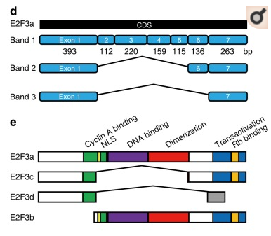

Dataset Baratheon
Classic RNA seq
Download:
https://www.dropbox.com/s/pkzry54eqb4w31y/baratheon.sorted.bam?dl=1
https://www.dropbox.com/s/64p4vi1p53r8dpf/baratheon.sorted.bam.bai?dl=1
Reference genome: human hg38
Reads reported on chr6 around gene E2F3
Neuroblastoma dataset

Slide 68
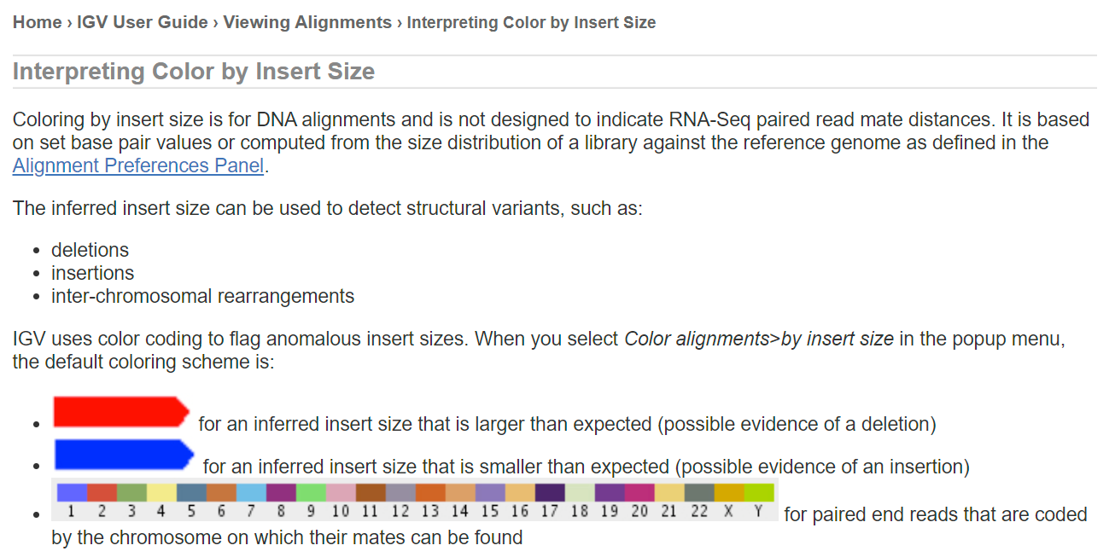
IGV coloring (default)

Slide 69
File Formats of Next Generation Sequencing

Slide 70


Some File formats loadable on IGV
FASTA: entire genome sequence
FASTQ: sequence format for many sequenced reads, each nucleotide is associated with a quality score
BAM: reads aligned on a genome. SAM is the unzipped, text version of it
BED: genomic regions
GFF3 or GTF: hierarchical gene structure
WIG or BIGWIG: coverage
Tip: Use Notepad++ to visualize large text files
https://notepad-plus-plus.org/downloads/
SAM, BAM, BED, GFF3, GTF, WIG and BIGWIG all use tab to separate fields. They are “tab-separated”

Slide 71
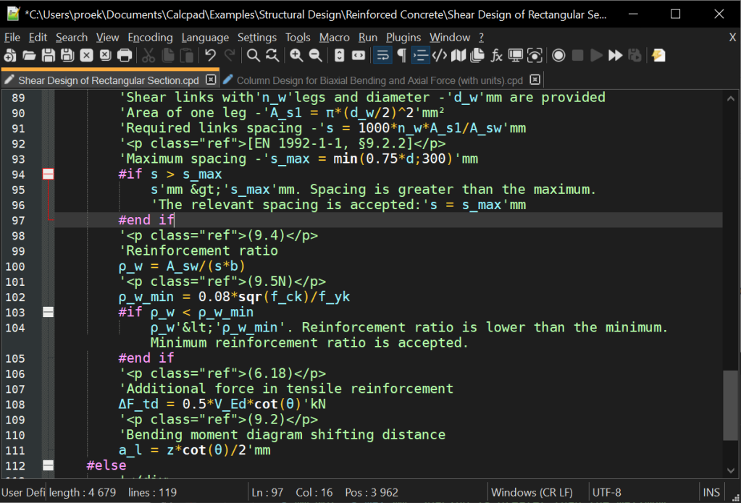

Good Free Editors for any text file
Windows:
Notepad++
Sublime Text
MacOSX
Sublime Text
Features
They can open larger files than Notepad/Textedit
They show the LINE NUMBER
They can turn on and off word wrapping
They can highlight code and special file types automatically

Slide 72
The FASTA file format
Can be a huge file (e.g. human genomes, ~3 billion bytes, i.e., 3GB)
Usually zipped (compressed to save space): .gz, .zip
It can have multiple headers, starting with >
Example: https://www.dropbox.com/s/al8hm4zth54pafu/read1.fa?dl=0
It contains less information than FASTQ: no quality associated to each nucleotide
FASTA is usually for sequences we trust fully, e.g. validated genomes, proteins, transcripts
FASTA can be loaded on IGV as a reference genome
IGV (local and web) have preloaded genomes in FASTA format
Check the comparison with the FASTQ file: https://www.dropbox.com/s/y89s1vo3rsk4f5w/read1.fq?dl=0

Slide 73
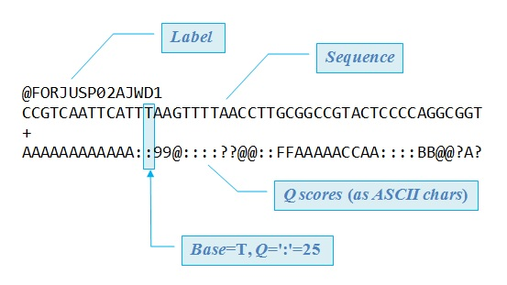
FASTQ format
FASTQ cannot be visualized directly on IGV! It lacks info on where it aligns on a genome

Slide 74
Phred+33 Quality encoding
!"#$%&'()*+,-./0123456789:;<=>?@ABCDEFGHIJ
0.........................26.............41

Slide 75
Phred+33 Quality encoding
!"#$%&'()*+,-./0123456789:;<=>?@ABCDEFGHIJ
0.........................26.............41
The numeric Quality Score (Q) is then converted to the error probability (P) using this formula:
Q = -10 log₁₀(P)
P = 10^{-Q/10}

Slide 76
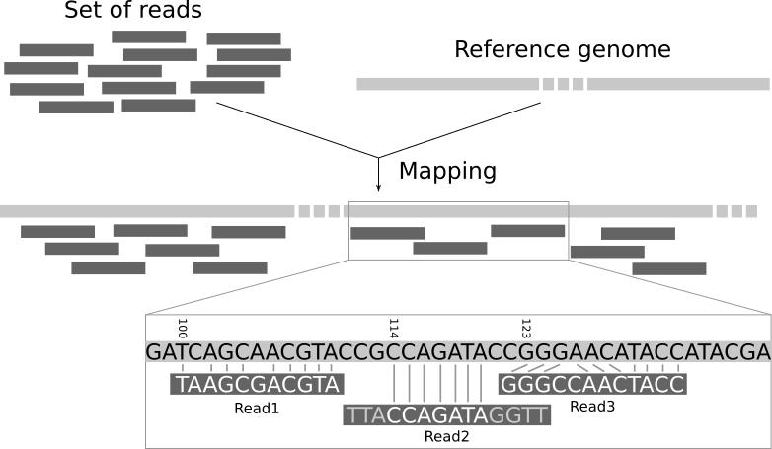
Aligning Reads on a Genome
Input: FASTQ
Tools (aligners)
DNA: BWA, Bowtie, Bowtie2
RNA: Tophat, STAR
Both: Hisat2
Output: SAM

Slide 77

The SAM format
Format used to store information on read alignment on a reference genome
Can be compressed (BAM)
Can contain only aligned reads (SAM < FASTQ)
...or it can contain all reads (you can then delete the original FASTQ files)
Download example here:
https://www.dropbox.com/s/5v1o1ldx6lmmmc3/WT1_sorted_chr19_small.sam?dl=0
Same data, two formats:
SAM
BAM
Text, Large
Binary, Small Less Large
Tip: Use Notepad++ to visualize non-huge text files

Slide 78
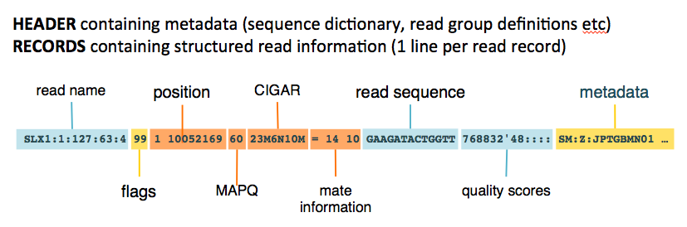
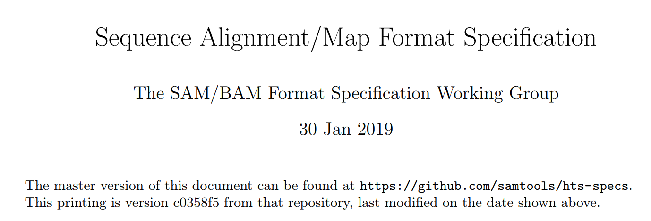
The SAM format
Format used to store information on read alignment on a reference genome
Can be compressed (BAM)
Can contain only aligned reads (SAM < FASTQ)
Can contain all reads (you can then delete the original FASTQ files)
https://samtools.github.io/hts-specs/SAMv1.pdf

Slide 79
The SAM Flag Column
FLAG

Slide 80
The SAM Flag Column
FLAG
The number is a univocal sum of individual flags, such as:
Read paired: 1
Both reads in pair are aligned: 2
Read not aligned: 4
Read in reverse strand: 10
Secondary alignment: 2048

Slide 81
The SAM Flag Column
E.g.
Read Paired: 0x1=1
Both reads in pair are aligned: 0x2=2
Read in reverse strand: 0x10=16
Second in pair: 0x80=128
Total: 128 + 16 + 2 + 1 = 147
FLAG
The number is a univocal sum of individual flags, in hexadecimal format (x) such as:
Read paired: 0x1
Both reads in pair are aligned: 0x2
Read not aligned: 0x4
Read in reverse strand: 0x10
Second in pair: 0x80
Secondary alignment: 0x2048
…etc

Slide 82
The SAM Flag Column
E.g.
Read Paired: 0x1=1
Both reads in pair are aligned: 0x2=2
Read in reverse strand: 0x10=16
Second in pair: 0x80=128
Total: 128 + 16 + 2 + 1 = 147
FLAG
The number is a univocal sum of individual flags, in hexadecimal format (x) such as:
Read paired: 0x1
Both reads in pair are aligned: 0x2
Read not aligned: 0x4
Read in reverse strand: 0x10
Second in pair: 0x80
Secondary alignment: 0x2048
…etc
Trick: if this column is an odd number, the dataset has paired reads
https://broadinstitute.github.io/picard/explain-flags.html

Slide 83
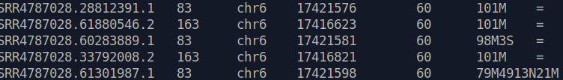
The SAM CIGAR Column
CIGAR

Slide 84
The SAM CIGAR Column
CIGAR
A string describing how the read aligns with the reference
It consists of one or more components
Each component comprises an operator and the number of bases which the operator applies to

Slide 85
The SAM CIGAR Column
CIGAR
A string describing how the read aligns with the reference
It consists of one or more components
Each component comprises an operator and the number of bases which the operator applies to
CIGAR string operators:
D Deletion; the nucleotide is present in the reference but not in the read
H Hard Clipping; the clipped nucleotides are not present in the read.
I Insertion; the nucleotide is present in the read but not in the reference.
M Match; can be either an alignment match or mismatch. The nucleotide is present in the reference.
N Skipped region; a region of nucleotides is not present in the read
P Padding; padded area in the read and not in the reference
S Soft Clipping; the clipped nucleotides are present in the read

Slide 86
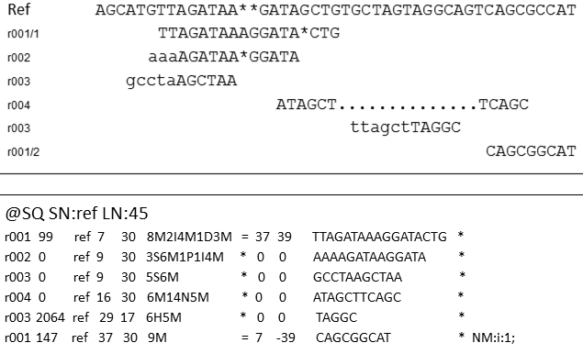
The SAM CIGAR Column

Slide 87
The SAM CIGAR Column

Slide 88
The SAM CIGAR Column

Slide 89
The SAM CIGAR Column

Slide 90
The SAM CIGAR Column

Slide 91
The SAM CIGAR Column

Slide 92
The SAM CIGAR Column

Slide 93
Read Length can be inferred from the CIGAR column
8 + 2 + 4 + 3 = 17
3 + 6 + 1 + 4 = 14
5 + 6 = 11
6 + 5 = 11
6 + 5 = 11
9 = 9
Counted in read length: M I S H
Not counted: D N P

Slide 94
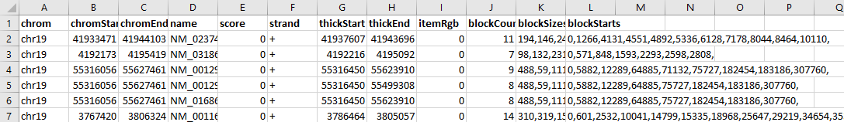

The BED file format
Download example and load it on IGV: https://www.dropbox.com/s/qj1eidd0glxfr9c/mm10.HouseKeepingGenes_chr19_fixed.bed?dl=0
The first three required BED fields are:
chrom - The name of the chromosome (e.g. chr3, chrY, chr2_random) or scaffold (e.g. scaffold10671).
chromStart - The starting position of the feature in the chromosome or scaffold.
chromEnd - The ending position of the feature in the chromosome or scaffold.
There are 9 additional optional BED fields such as:
name - Defines the name of the BED line. This label is displayed to the left of the BED line in IGV when the track is open to full display mode or directly to the left of the item in pack mode.
score - A score between 0 and 1000, the score value will determine the level of gray in which this feature is displayed
BED files are useful to store information such as:
Gene locations
Transcription factor binding sites
Promoters
Enhancers
Regions of opened/closed chromatin

Slide 95
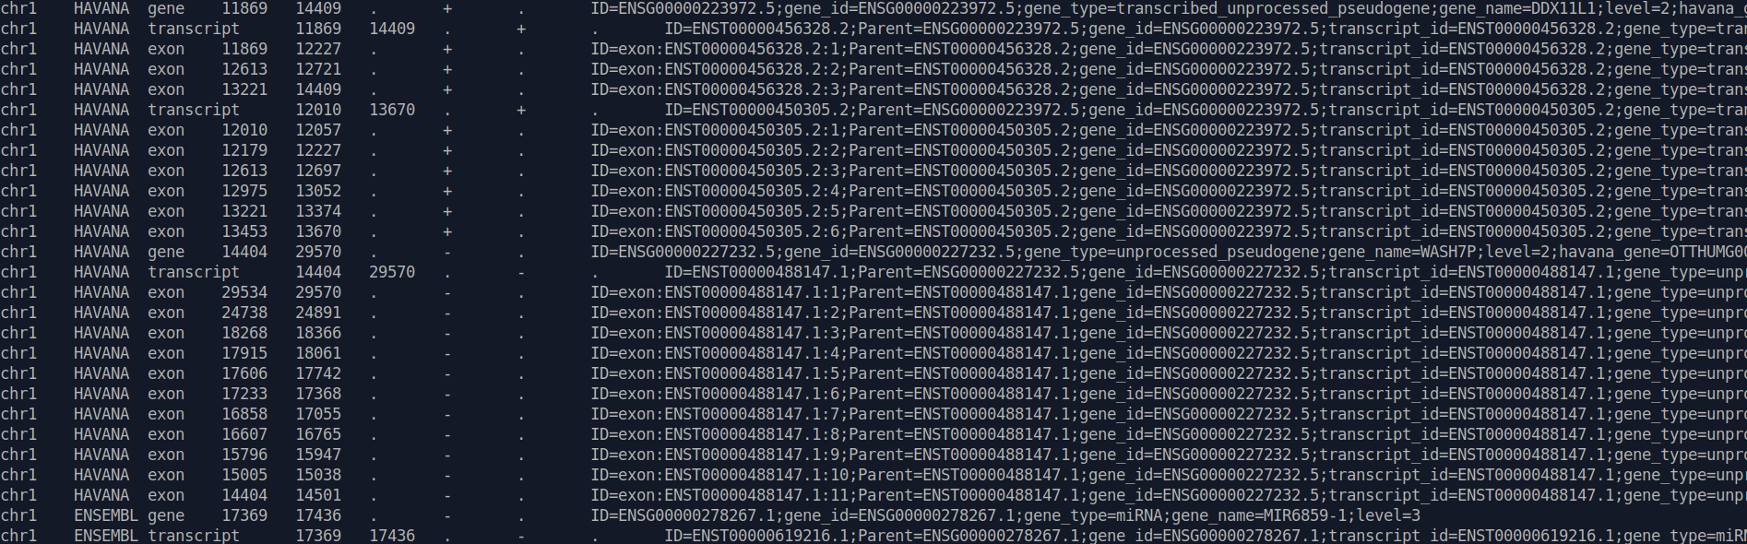
The GFF3 and GTF file formats
seqid - Chromosome/Scaffold/Reference name
source - Source that annotated this feature
type - Type of feature (e.g. gene, transcript, exon)
start - Start position of the feature
end - End position of the feature
score - A floating point value (can be used for e.g. peak intensity for ChIP-Seq features)
strand - defined as + (forward) or - (reverse).
phase - 0, 1 or 2. For coding sequences. “0” means “in frame”, 1 and 2 mean that the codon is shifted 1 or 2 bases
attributes - Additional information about each feature. E.g gene_type, gene_name
GFF3/GTF are the main choice for gene annotation: like BED, they show location, but also hierarchy (e.g., gene→transcriptS→exons)

Slide 96
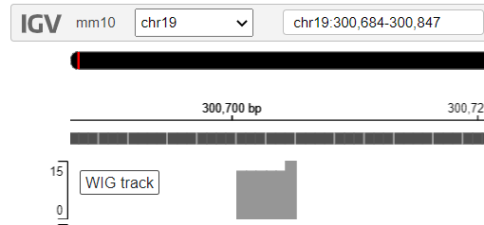

The WIG and BIGWIG file formats
Same as the SAM/BAM dichotomy:
WIG files are text-based
BIGWIG files are compressed
WIG files show scores at a given genomic location
WIG Without span:
variableStep chrom=chr19
300701 12.5
300702 12.5
300703 12.5
300704 12.5
300705 12.5
300706 15
WIG With span (same info as before, useful to save space):
variableStep chrom=chr19 span=5
300701 12.5
300706 15
Download the example and load it on IGV
https://www.dropbox.com/s/6pugvnev0ezbzih/example.wig?dl=0
To visualize it, you should go to the genomic coordinate specified
WIG files are useful to visualize quantities across the genome such as:
Gene expression (RNA-Seq)
TF binding strength (ChIP-Seq)
Evolutionary conservation
GC content
Mutational distribution

Slide 97
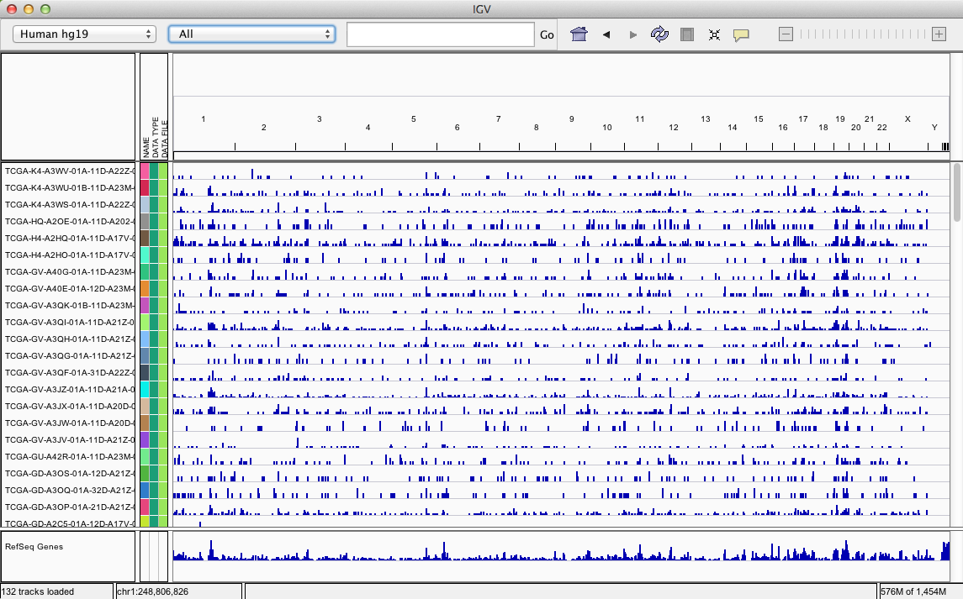
Mutational distribution in Cancer Samples
Lots of WIG files from TCGA (The Cancer Genome Atlas):

Slide 98


Exercises (1)
ENSEMBL: Repository for genomes and standard gene annotations
Explore all genomes available in the official ENSEMBL repository:
http://www.ensembl.org/info/data/ftp/index.html
How many species?
How many versions?
Which file types can you download?
Download a GTF for mouse mm39/GRCm39:
How many lines?
HARD: How many gene entries?
The Mus_musculus.GRCm39.108.gtf.gz GTF file is at http://ftp.ensembl.org/pub/current_gtf/mus_musculus/
Note: Notepad++ on Windows is your friend, but it is still a huge task
https://notepad-plus-plus.org/downloads/
for Mac, Sublime Text is an alternative
Note: .gz files (GZIP) can be unpacked with the 7-zip tool https://www.7-zip.org/

Slide 99
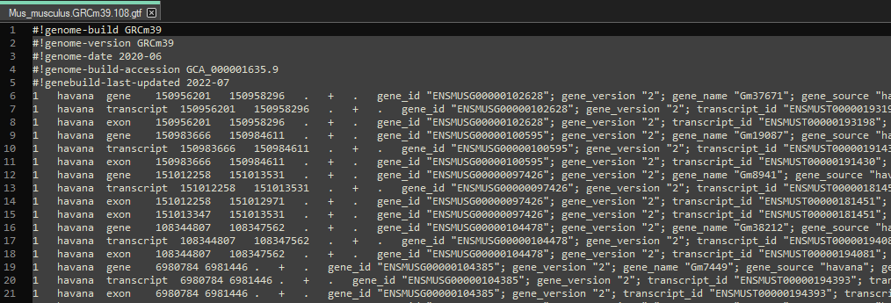
Solution: counting the number of annotated genes
This is the file:
You have to count the number of gene lines

Slide 100
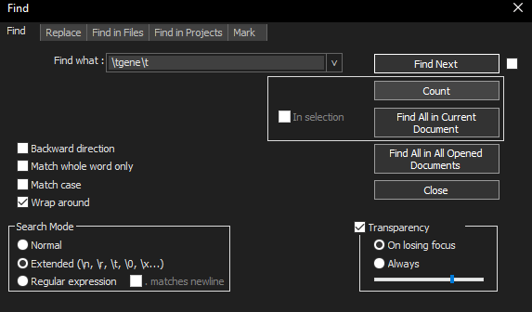


Solution: counting the number of gene entries
With Notepad++
Search... Find...
Turn on "extended"
Find what: \tgene\t
\t is the TAB!
Click on "Count"
With Sublime Text
Find... Find...
Bottom bar, click on Regular Expressions
Insert \tgene\t
Click on "Find All"

Slide 101

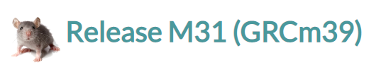
Exercises (2)
GENCODE: Repository for detailed gene annotations
Explore Gene annotations at the GENCODE repository
https://www.gencodegenes.org/
Highly curated gene annotation (i.e., also non-coding, rare isoforms, etc.)
How many species?
Explore the various gene annotations
Download the GFF3 for mouse mm39 (a.k.a. GRCm39);
M31 is the annotation version, mm39 is the sequence version
how many lines?
how many gene lines?
On local IGV, load directly the GENCODE GFF3 and compare it to the default Refseq gene annotation
Note: .gz files (GZIP) can be unpacked with the 7-zip tool https://www.7-zip.org/
HARD: Try to load the file on IGV: this is possible with the local (not web) version
Files ready to load: sorted GFF3 and index
Compare this annotation with the default RefSeq gene annotation

Slide 102
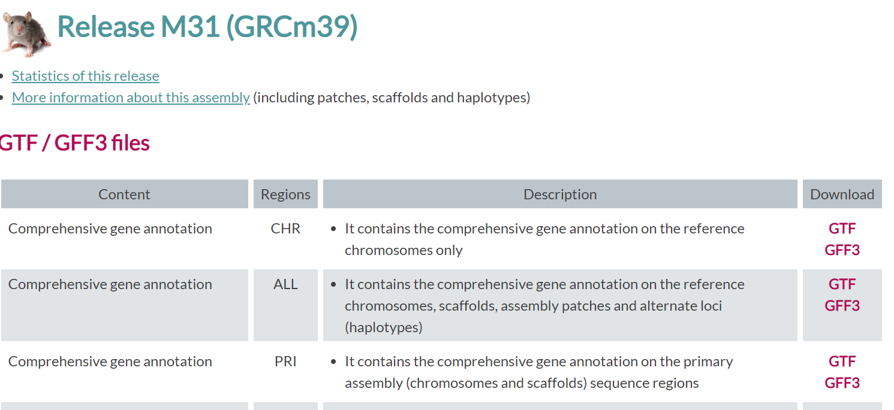
Solution: how to load a GFF3 on IGV? (1)
https://www.gencodegenes.org/mouse/
This one is a good one

Slide 103
Solution: how to load a GFF3 on IGV? (2)
Now, try to download the file (gencode.vM31.annotation.gff3.gz)
M31 is the annotation version
mm39 was the sequence version
If the download is slow, I have a backup copy here: link
Then, unzip it (using e.g. the 7-zip program)
Zipped (not loadable by IGV): gencode.vM31.annotation.gff3.gz
Unzipped: gencode.vM31.annotation.gff3

Slide 104
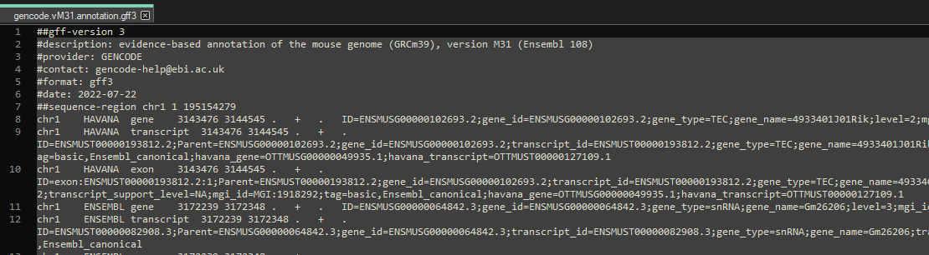
Solution: how to load a GFF3 on IGV? (3)
Check the file gencode.vM31.annotation.gff3 with a good editor
Notepad++ or Sublime Text
It should look like this:

Slide 105
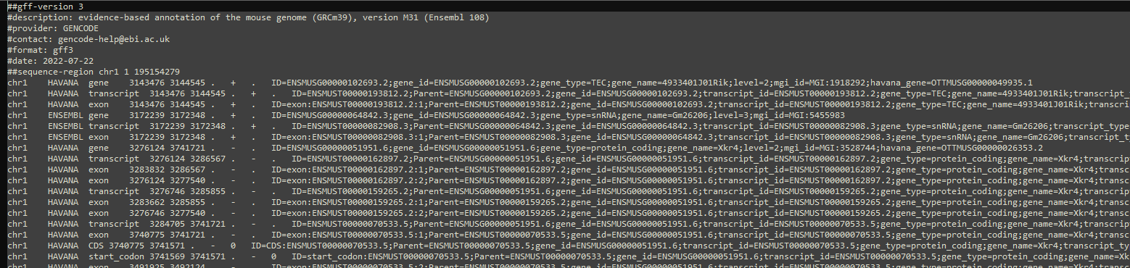
Solution: how to load a GFF3 on IGV? (4)
You can turn off Text Wrapping
Click on View, then deselect "Word Wrap"
This will make the file easier to assess: ONE LINE = ONE TRACK

Slide 106
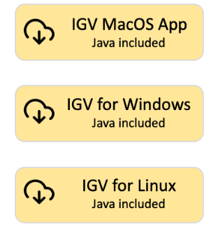
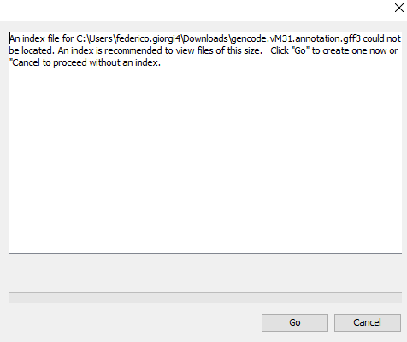
Solution: how to load a GFF3 on IGV? (5)
Let's try to load the GFF3 on IGV
Use the local IGV
https://software.broadinstitute.org/software/igv/download
Online IGV: weak
Select the correct genome (top-left: Mouse mm39)
Load the GFF3
Local IGV: File... Load from File
ERROR!

Slide 107
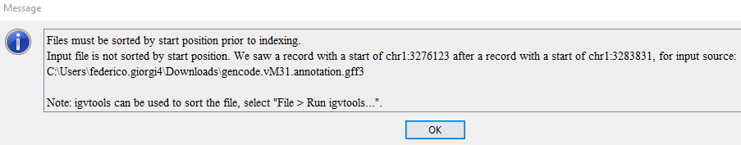
Solution: how to load a GFF3 on IGV? (6)
ERRORS!
Truth be told, IGV tells you what to do...

Slide 108
Solution: how to load a GFF3 on IGV? (7)
GFF3 files need to be prepared to be loaded on IGV
1) Sort the GFF3
2) Index the GFF3

Slide 109

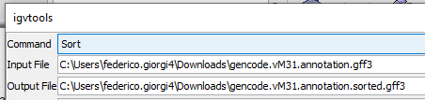
1) Sorting the GFF3
Click on Tools
Run igvtools...
Command: sort
input file: gencode.vM31.annotation.gff3
Click on Run
Wait one minute (if it freezes or crashes, sorted file otherwise is here)
gencode.vM31.annotation.sorted.gff3

Slide 110
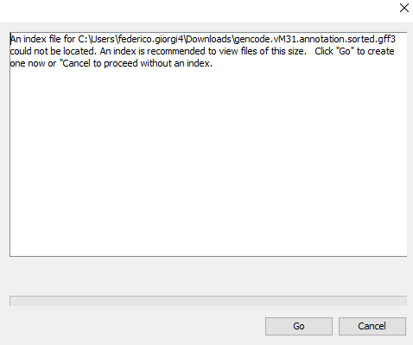
2) Indexing the GFF3
Once you have sorted the file, try to load it
File will be called: gencode.vM31.annotation.sorted.gff3
Once prompted, click on GO
It takes max 1 minute to index it
If for some reason the index file does not load, you can find it here:
https://www.dropbox.com/s/jhhzzgp0v3nn2mo/gencode.vM31.annotation.sorted.gff3.idx?dl=0

Slide 111
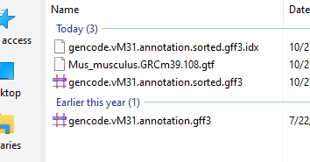
Solution: how to load a GFF3 on IGV? (8)
At some point, if everything worked, you should have:
Index file:
https://www.dropbox.com/s/jhhzzgp0v3nn2mo/gencode.vM31.annotation.sorted.gff3.idx?dl=0
Sorted file (zipped):
https://www.dropbox.com/s/vywr8hklz0be3l1/gencode.vM31.annotation.sorted.gff3.zip?dl=0
File... Load from File...
Load gencode.vM31.annotation.sorted.gff3 (unzipped!)

Slide 112
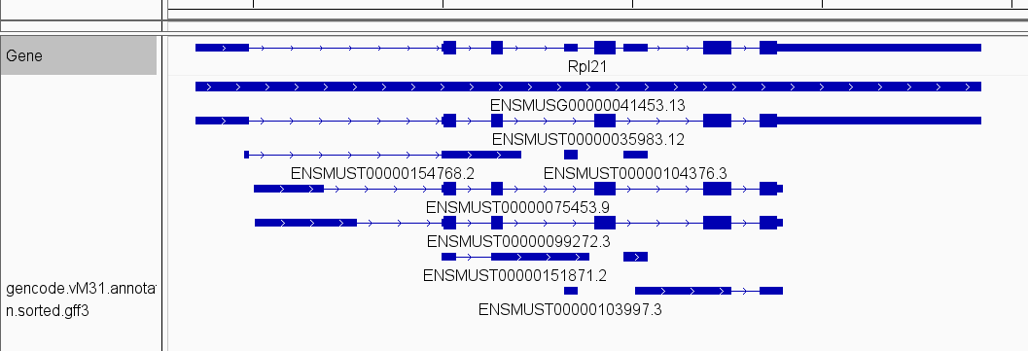
GENCODE annotation has many more tracks than default
Source: RefSeq or ENSEMBL
Source: GENCODE

Slide 113


GENCODE: constant updates in annotation

Slide 114


How was the BAM files I gave you generated?
On LINUX, with a high-performance machine (64GB of RAM)
Start with FASTQ
Clean it removing low quality reads (FILTERING)
Clean it by removing low quality portions of reads (TRIMMING)
The program fastp does both
Then, prepare the genome by building an alignable form of it with hisat2

Slide 115

Aligning the prepared FASTQ on the prepared GENOME
fastp
Genome
Cleaned FASTQ
Experiment
FASTQ
Hisat2-build
Alignment
Hisat2
Built Genome
samtools sort
samtools index
BAM
Sorted BAM
Add BAI file for IGV
GTF/GFF3 annotation
samtools view
featureCounts
Keep only chr19 alignments so students can download it
Optional gene expression quantification

Slide 116

Converting BAM to gene expression
The predominant reads within a BAM originating from an RNA-Seq experiment derive from messenger RNAs
Short (36-250 bases)
High error rates (1%)
Hundreds of millions of reads
Many reads span exon-exon junctions
RNA-seq reads

Slide 117

Converting BAM to gene expression
Peculiarities of RNA-Seq short reads:
Alignment is not uniform (proportional to transcript expression)
Alignment on the same transcript is not uniform (exonucleases cut from 5’ and 3’)
When aligned on the genome, eukaryotic RNASeq reads can span across introns
Alternative isoforms
RNA editing

Slide 118
Getting counts from RNA-Seq
GFF3 annotation
}
Htseq-count
Gene Counts
BAM alignment

Slide 119
Getting counts from RNA-Seq
GFF3 annotation
}
Htseq-count
Gene Counts
BAM alignment
Exon Counts
Transcript Counts
Anything Counts

Slide 120

Getting counts from RNA-Seq
GFF3 annotation
}
Htseq-count
Gene Counts
BAM alignment
Exon Counts
Transcript Counts
Anything Counts

Slide 121
Getting counts from RNA-Seq
GFF3 annotation
}
Htseq-count
Gene Counts
BAM alignment
Exon Counts
Transcript Counts
Anything Counts
Recent alternative to Htseq-count: featureCounts

Slide 122

Example of count matrix
Rows are genes. Columns are samples.
Counts indicates the number of reads for that gene in that sample
This comes from Blood samples, GTEX dataset of human physiological gene expression:
Samples
Genes

Slide 123



Getting NGS data from public databases
GEO – Gene Expression Omnibus
American (NCBI, Bethesda, Maryland)
Largest repository of high-throughput data in the World
NGS
Microarrays
https://www.ncbi.nlm.nih.gov/geo/

Slide 124


Getting NGS data from public databases
ArrayExpress /ENA / BioStudies
European (EBI, Hinxton, United Kingdom)
More recent than GEO (better search tools)
GEO and ArrayExpress are partially redundant
Example 1 (BAM files): https://www.ebi.ac.uk/biostudies/arrayexpress/studies/E-GEOD-63472?query=single-cell
Example 2 (FASTQ files): https://www.ebi.ac.uk/biostudies/europepmc/studies/S-EPMC8270128

Slide 125


Getting NGS data from public databases
Sequence Read Archive SRA
Subset of NCBI GEO specifically for NGS data (no microarrays)
Raw data is available
Essentially FASTQ files
Compressed and optionally encrypted in the SRA format

Slide 126
The SRA (Sequence Read Archive) Toolkit
Common pipeline when you start from a public dataset
Find a suitable dataset (ArrayExpress or GEO)
Find a link to the sample IDs (SRA or FASTQ)
Download SRA (encrypted FASTQ) or FASTQ files
(Optional) Convert SRA files to FASTQ files
Quality control of FASTQ files
Optional FASTQ Trimming/Adapter removal
FASTQ alignment on reference genome (BAM)
BAM visualization
Downstream Analysis

Slide 127
The SRA (Sequence Read Archive) Toolkit
Common pipeline when you start from a public dataset
Find a suitable dataset (ArrayExpress or GEO)
Find a link to the sample IDs (SRA or FASTQ)
Download SRA (encrypted FASTQ) or FASTQ files
(Optional) Convert SRA files to FASTQ files
Quality control of FASTQ files
Optional FASTQ Trimming/Adapter removal
FASTQ alignment on reference genome (BAM)
BAM visualization
Downstream Analysis
}
NCBI’s SRA Toolkit

Slide 128
Federico M. Giorgi, PhD
Department of Pharmacy and Biotechnology
federico.giorgi@unibo.it

